Slide 1
Comparative Analysis of Image Classification Performance: PyTorch and TensorFlow
CSE 598: Data Intensive Systems for Machine Learning Group 10 - Machine Learning Misfits ( Deva Dharshini Ravichandran Lalitha, Junaita Davakumar, Vallikannu Chockalingam )

Slide 2
Introduction
Our project aims to implement a standard machine learning workload, specifically an image classification task, using the CIFAR-10 dataset.
We initially planned to use three frameworks—Velox, PyTorch, and TensorFlow—but due to technical limitations, our analysis focuses on PyTorch and TensorFlow.
This task not only tests the practical application of these frameworks but also their performance in terms of training speed, accuracy, and resource utilization.

Slide 3

Fig 1: Simple explanation of image classification

Slide 4
Problem Statement
Image classification is pivotal in machine learning, serving as a benchmark for evaluating various ML platforms.
PyTorch and TensorFlow are popular choices for their robust features and community support. However, Velox was also considered to explore potential advantages in machine learning functions.
Due to unforeseen challenges with Velox, this analysis provides a comparative insight between PyTorch and TensorFlow, highlighting the need for effective tools in real-world ML applications.

Slide 5
Dataset Description
The CIFAR-10 dataset comprises 60,000 images, each 32x32 pixels in full color, spanning 10 distinct categories such as animals and vehicles.
This diversity makes CIFAR-10 an excellent benchmark for evaluating the capability of ML models to recognize and classify complex patterns.

Slide 6
Model Architecture
Our model is a Convolutional Neural Network (CNN), optimal for grid-like data like images.
Key components of our CNN include Convolutional Layers for feature extraction, ReLU Activation Functions to introduce non-linearity, Pooling Layers to reduce dimensionality, and Fully Connected Layers to make classification predictions.

Slide 7
Implementation Plan
For PyTorch, we leverage its dynamic computation graph to build and train the CNN model, allowing for flexibility during development.
For TensorFlow, we use its static computation graph alongside Keras, facilitating a streamlined and efficient model construction process.

Slide 8
Challenges with VeloxML
We encountered several obstacles with VeloxML, including a lack of comprehensive documentation, insufficient community support, and technical compatibility issues that prevented its implementation.
Had VeloxML been feasible, it might have offered unique advantages like optimized data preprocessing and integration of advanced ml_functions directly impacting performance metrics.

Slide 9
Performance Evaluation Criteria
Our performance evaluation includes measuring Training and Inference Time, Accuracy, Resource Utilization (CPU/GPU and memory), and Development Experience across both frameworks.
These criteria are used to determine the most efficient and effective framework for image classification tasks.

Slide 10
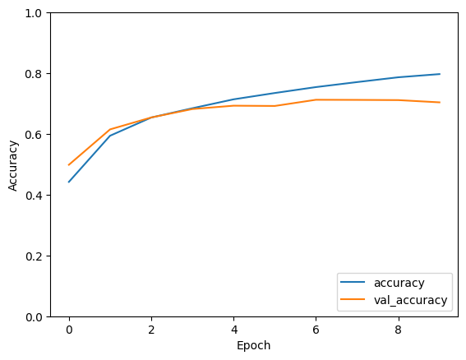
Model Performance of TensorFlow
The graph displayed represents
the model's learning progression
over epochs.
The blue line indicates
the accuracy on the training set
The orange line represents
the validation accuracy.

Slide 11
As observed, both accuracies increase over time, indicating that the model is learning effectively.
However, the validation accuracy appears to plateau towards the last epochs, which could suggest the beginning of overfitting or that the model has reached its learning capacity with the current architecture and hyperparameters.
The goal is to have both lines as high as possible, with the validation accuracy closely tracking the training accuracy, which would suggest good generalization.
In this case, the model seems to perform well, but there might be room for improvement, possibly by tuning hyperparameters, augmenting the dataset, or modifying the model architecture

Slide 12
Evaluation Metrics
Machine Learning Library | Loss | Accuracy
PyTorch | 0.217 | 72%
TensorFlow | 0.884 | 70%

Slide 13
Expected Outcomes
We expect to reveal practical performance trade-offs between PyTorch and TensorFlow, providing insights into each framework's strengths and limitations.
This will aid in making informed decisions for selecting suitable frameworks based on specific project needs, like development speed, performance precision, or resource constraints.

Slide 14
Conclusion
This project enhances our understanding of machine learning systems and frameworks, aligning with our course's focus on the architecture and design principles of ML systems.
Through this analysis, we've gained valuable insights that will guide future framework selection for optimized performance and efficiency in ML projects.

Slide 15
References
https://v-snehith999.medium.com/correlate-image-classification-in-keras-and-pytorch-cifar-10-snehit-vaddi-58ff7ebe9ad8
https://medium.com/analytics-vidhya/basic-important-functions-of-pytorch-pytorch-series-week-1-snehit-vaddi-8dc8aee5b5a5
https://medium.com/bitgrit-data-science-publication/building-an-image-classification-model-with-pytorch-from-scratch-f10452073212

Slide 16
Questions?
Thank you!

